Slide 1
GROUP ONE
1. Will Araka 23-0773.
2. Alex Kamwende 22-1202.
3. Triza Nyoike 22-3298.
4. Annrisper Wanjiku 22-3108.

Slide 2

Fitness Management Web Application
This presentation outlines our innovative Fitness Management Web Application, designed to address gaps in the current fitness market. We aim to provide an accessible, cloud-based platform for personalized workouts, progress tracking, and community engagement.
Our solution caters to fitness enthusiasts, novices, and small gym clubs, offering a scalable and user-friendly experience to maximize fitness journeys.

Slide 3
Project Background and Introduction
Project Background
Introduction
Modern fitness apps often lack affordable professional guidance, sociability, or personalization. Our Fitness Management Web Application addresses these by offering a cloud-based platform for bespoke workouts, metric monitoring, trainer connection, and community engagement. It's an accessible, scalable solution for all fitness levels.
The Fitness Management web application is a web portal created to assist consumers in accurately tracking their fitness objectives. It motivates users to track exercises, monitor progress, set personal goals, and engage with friends or coaches for inspiration and accountability. Built with React, Node.js, and MongoDB, and hosted on Google Cloud Platform, it ensures scalability and accessibility.

Slide 4
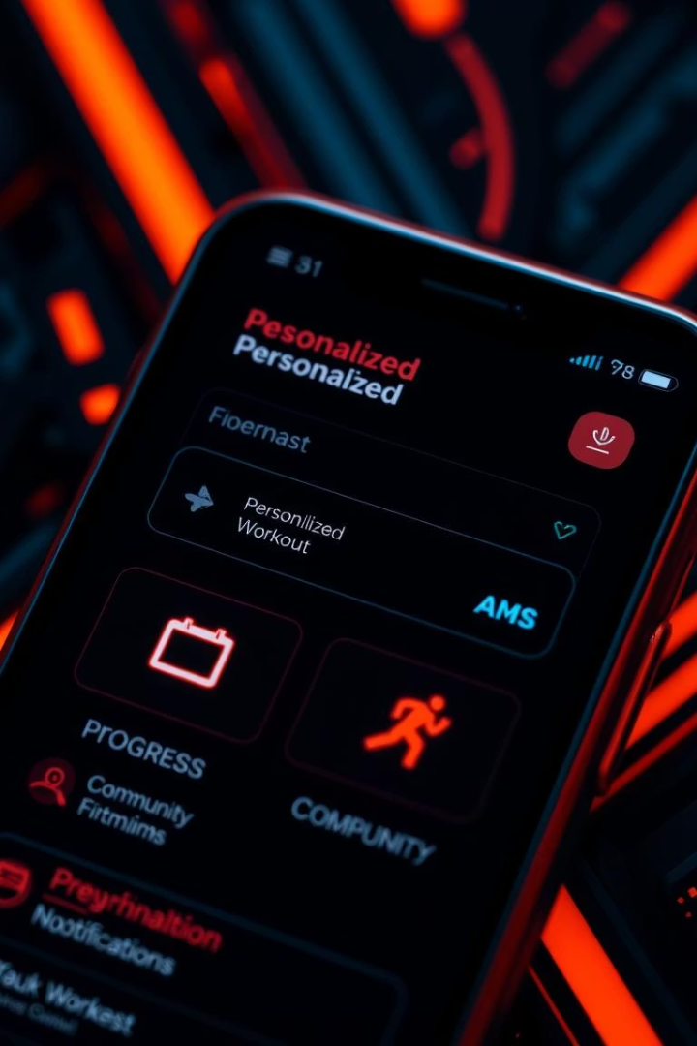



Key Features of Our Application
Personalized Workout Plans
Progress Tracking
Users can design or modify workouts according to their objectives, tastes, and fitness levels.
Log workouts, monitor statistics (calories burned, weight lifted), and use graphs to see your progress.
Notifications & Reminders
Community & Trainer Integration
Automated email or in-app notifications for workout schedules and goal milestones.
Connect with fitness groups for challenges or book sessions with qualified instructors.

Slide 5

Advantages Over Existing Solutions
1
Personalization
Unlike generic apps, our system offers personalized exercise programs and goal-setting tools tailored to individual needs.
2
Social Responsibility
Encourages social responsibility through community challenges, addressing poor app involvement seen in other platforms.
3
Affordability
Provides free core features with optional premium trainer services, making it accessible for all users.
4
Accessibility
Cloud-based and available on any browser-enabled device, guaranteeing user flexibility and broad reach.

Slide 6
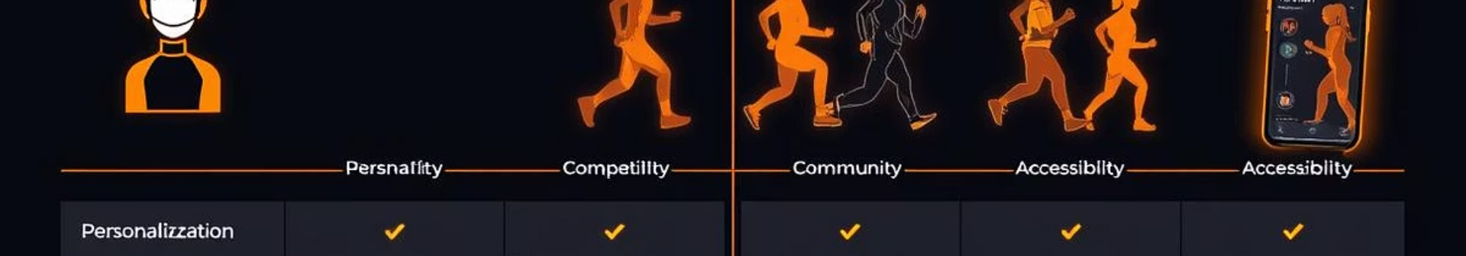
Addressing Limitations of Existing Systems
MyFitnessPal
Lacks robust community features; nutrition-focused.
Full personalization for workouts; strong community engagement.
Strava
Primarily for runners/cyclists; limited gym support.
Broad community features; supports diverse workout types.
Fitbit
Relies on wearables; basic community features.
No hardware required; enhanced social tools.
Nike Training Club
Limited customization; premium for advanced features.
Highly customizable plans; free core features.

Slide 7
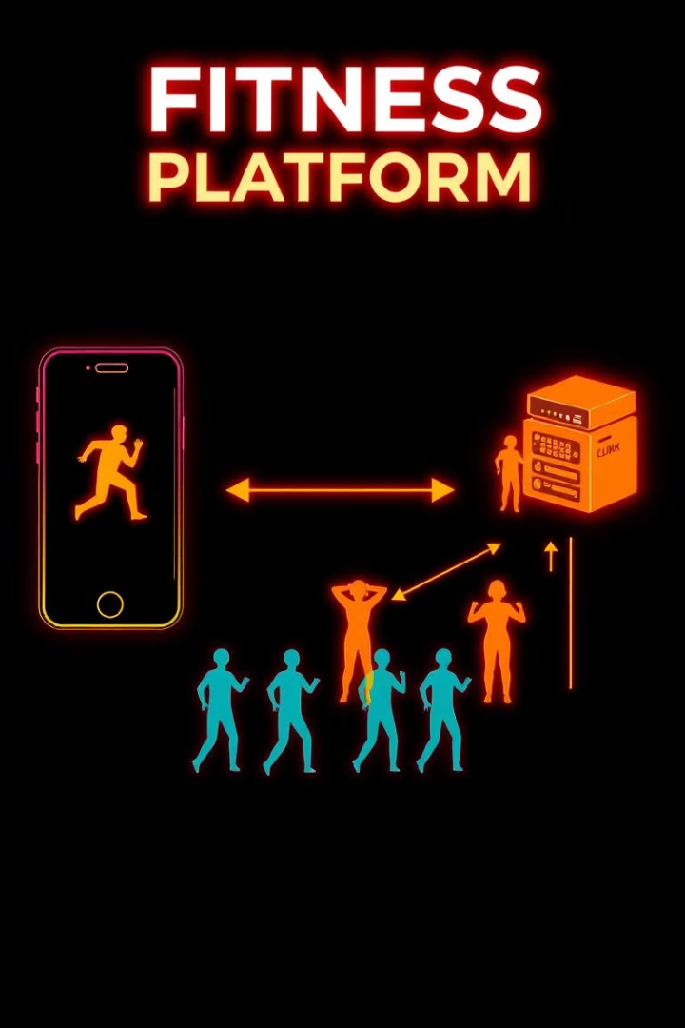



Project Objectives and Classification
Main Objective
Create a user-friendly, cloud-based platform for custom exercise programs, progress visualization, and community engagement to boost fitness monitoring and motivation.
Specific Objectives
Easy web interface for custom workout plans.
Visual graphs for progress monitoring.
Community elements and trainer interaction.
Cloud deployment for scalability and availability.
System Classification
Web-based application (desktop, tablet, mobile).
Cloud-hosted (GCP) for reliability.
Fitness and Social Platform.
Potential Open Source Project.

Slide 8
Functional and Non-Functional Requirements
Functional Requirements:
Non-Functional Requirements:
User Authentication: Secure sign-up, login, and logout (email/OAuth).
Performance: Dashboards load within 2 seconds.
Workout Management: Create, edit, and log workouts with customizable exercises.
Scalability: Supports 1,000 concurrent users without degradation.
Progress Tracking: Log and visualize fitness metrics using interactive charts.
Security: Encrypts user data (HTTPS, secure
storage).
Community & Trainer Features: Join challenges, follow peers, book trainer sessions.
Usability: Intuitive interface, learning curve less than 10 minutes.

Slide 9
Project Setup and Team Roles
Project Infrastructure:
Frontend: Built using React for a responsive interface, enabling dynamic workout dashboards and community feeds.
2. Backend: Developed using Node.js with Express for API endpoints to manage workouts, user profiles, and trainer bookings.
3. Database: MongoDB for storing user data, workout logs, and community interactions, offering flexibility for dynamic fitness data.
4. Cloud Hosting: Deployed on Google Cloud Platform (GCP) using Cloud Run for serverless deployment or App Engine for managed hosting, ensuring scalability.
5. Development Tools:
VS Code: For coding and debugging.
Docker: For containerizing the application to ensure consistent environments.
Postman: For testing API endpoints.
CI/CD Pipeline: Configured on GitHub Actions for automated testing and deployment.

Slide 10
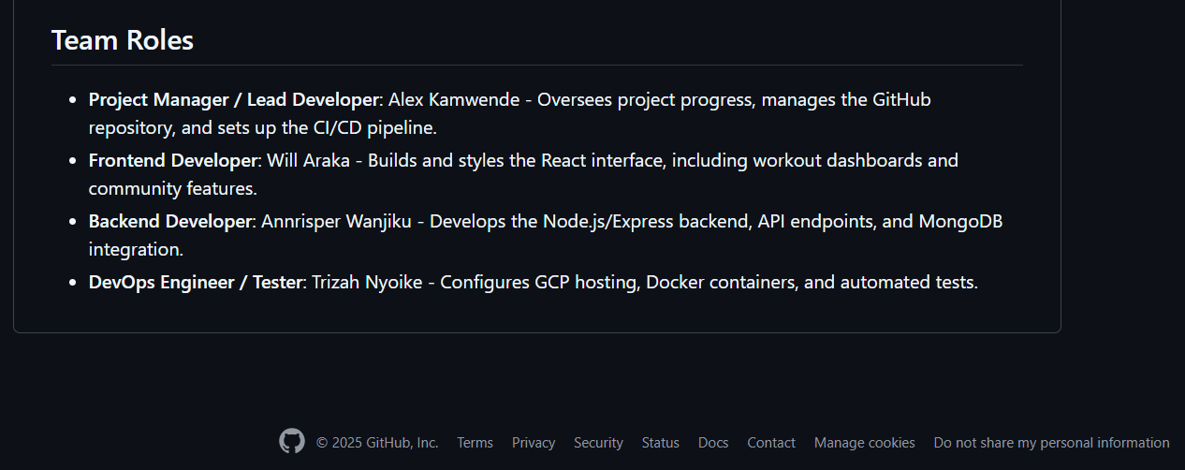
TEAM MEMBER ROLES:

Slide 11
THANK YOU!

